Slide 1


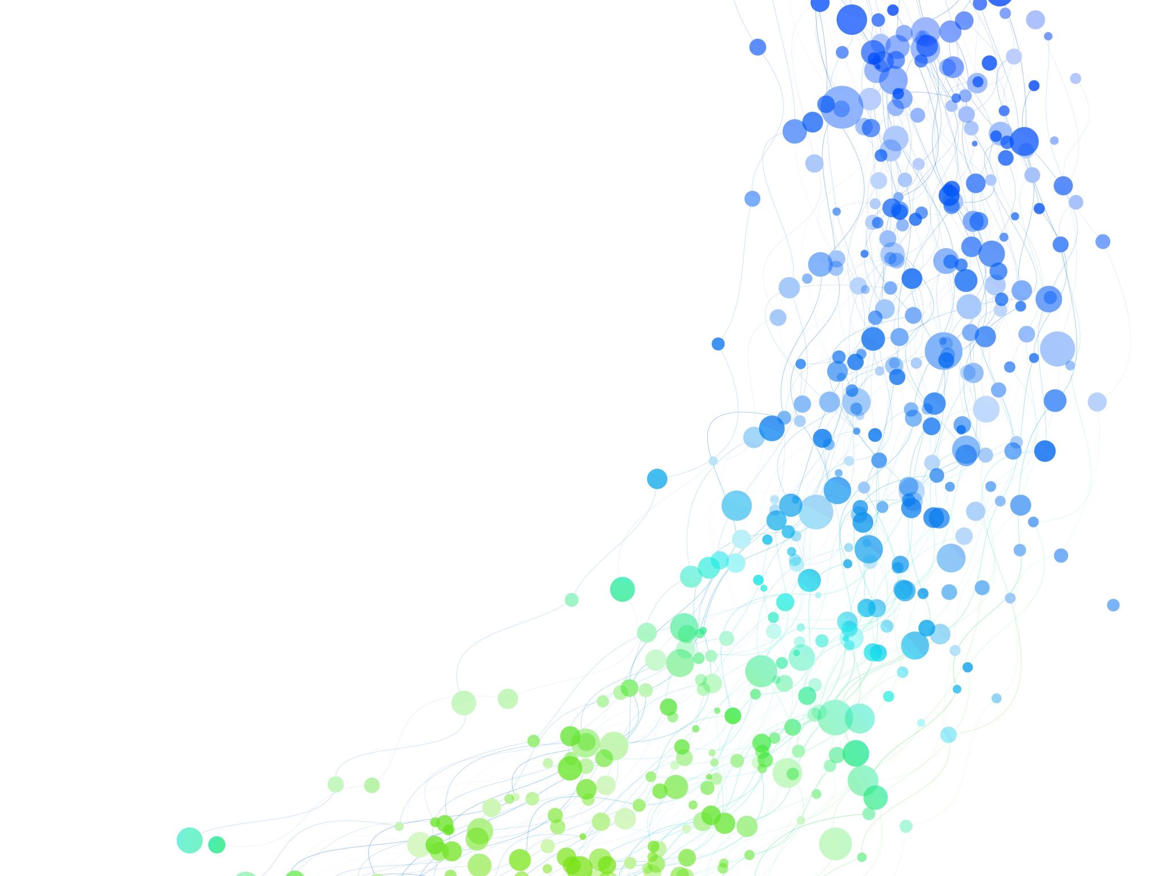
Stripe merchant churn
Content:
Executive summary
Merchant segmentation
Merchant churn- identification and prediction
Exploratory data analysis
Future scope

Slide 2








Stripe merchants
Acquiring a new customer can cost five times more than retaining an existing customer
Business types
Expensive transactions
Loyalty
Stripe
Frequent transactions
Loyal and Active merchants
Products
At Risk
Potential
>
Business location
Merchant processing with stripe continues to make transactions with stripe
Apply different promotional and retention strategies for different segments
Churned merchants
Non churned merchants
Loyal merchants
Active merchants
Non active merchants
Merchants who stopped processing with Stripe after an interval
Continuous processing with Stripe
What interval?
Identify them?
Reward them
Upsell high priced, offer memberships
Send personalized emails
Predict them?

Slide 3


Executive summary
Time period: 2033-2034
Merchant ID
Transaction date
Transaction amount
Loyal, 18%
Churn: If merchant stopped processing with stripe
To identify and predict the churn
Active, 68%
Should not have made any transaction in last 60 days (Active segment) or 30 days (Loyal segment)
Should be in Loyal merchant and Active merchants' segments
Should have made at least 3 transactions in given 2 years
Churned merchant
2.4K
14,351 merchants
Merchants make transactions
One-time, 14%
To understand their payment activity and identify different kind of merchant business
Loyal merchants
Transacted very recently and did shop frequently
Active merchants
Transacted often and frequently
One-Time merchants
Transacted once and didn't return
On an avg 1 month time gap between the consecutive transactions
On an avg 6 months tenure with stripe
Contributed very less to overall revenue
Gap between consecutive transactions is very large
Contributed large amount to overall revenue
Longer tenure duration with stripe
Gap between consecutive transactions is very less
Contributed less amount to overall revenue
Merchant churn prediction
Model: Logistic Regression
Train-Test split: 60%-40%
Accuracy : 96%

Slide 4
Methodology
Data cleaning
Feature generation
Missing value treatment
Outlier treatment
Segmentation
Churn identification
Exploratory data analysis
Churn prediction
Recency
K-means clustering
Logistic regression
Frequency
Monetary
Avg trnx amount
Gap b/w trnx
Tenure span

Slide 5

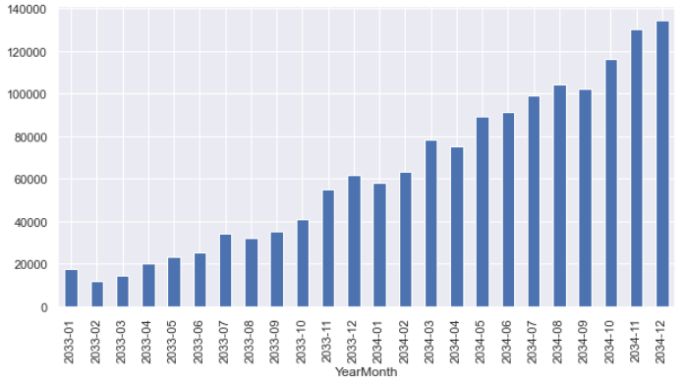
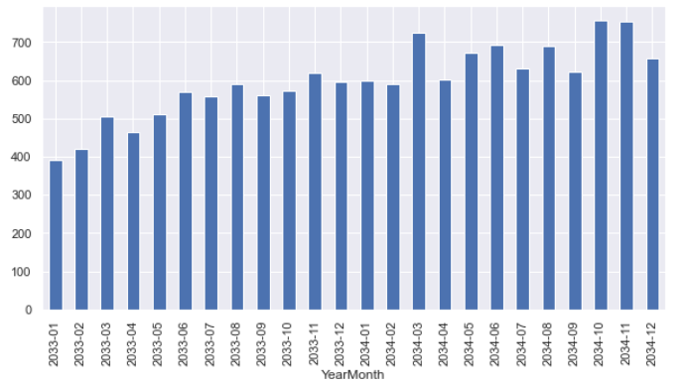
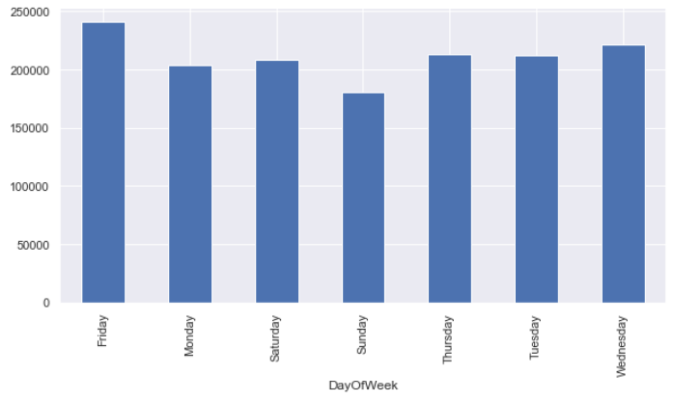
Exploratory data analysis
Time period: 2033-2034
Average number of trnx
33
Top 3 highest ordering merchants
Total trnx amount
fa634928a7
1ddaea9838
644f4b8914
$ 16,332
14,351 merchants
Top 3 most generating revenue merchants
Average merchant tenure
200 days
44ee3ec72c
bdebc6831e
654930c922
475 K trnx
$ 234 M
Average merchant trnx
$ 381
Most number of transactions are placed between 5pm and 7pm
Average gap b/w trnx
26 days
No of trrnx vs year-month
No of new merchants vs year-month
No of trnx vs weekdays
Number of transactions & the amount of transactions has constantly and exponentially increased over the time span of 2 years
Number of new customers processing with Stripe has constantly increased over 2 years
Most number of transactions are placed on Friday followed by Wednesday and Thursday

Slide 6



Merchant segmentation
Merchant ID
Transaction date
Transaction amount
Loyal, 18%
Active, 68%
Data
One-time, 14%
14,351 merchants
Recency
Frequency
Monetary
Avg trnx amount
Tenure period
Gap b/w consecutive trnx.
Loyal merchants
Active merchants
Feature generation
Shopped very often & frequently
Did shop recently
Contributed huge to overall revenue
Longer tenure with stripe
Gap between consecutive transactions is very less
Constitute ~18% of all customers
Shopped often and frequently
Contributed less to overall revenue
On an avg 6 months tenure with stripe
On an avg 1 month time difference between the consecutive transactions
Constitute ~68% of all customers
Missing value treatment and Outlier treatment
Principal component analysis for dimensionality reduction
One-time merchants
Shopped once and did not come back
Did not shop recently
Very less revenue contributors
Less tenure with stripe
Gap between consecutive transactions is very large
Constitute around 14% of total merchant base
Feature 1
Feature 2
Feature 3
Feature 4
Feature 5
Applied K mean clustering on above 5 features

Slide 7
Merchant churn- identification and prediction
Considering Loyal merchant and Active merchant segments for identification and prediction of merchant churn
Total 14,351 merchants
Recent trnx within 22 days
Recent trnx within 4-5 months
Considered 8,125 merchants
Frequency of 78 trnx in 2 years
Frequency of 12 trnx in 2 years
2,409 (30%) churned merchants
5,716 (70%)
non-churned merchants
Gap of 7 days b/w consecutive trnx
Gap of 29 days b/w consecutive trnx
Loyal merchants
Active merchants
Train-Test split of 60%-40%
Merchant did make trnx within last 30 days
Merchant did not make any trnx within last 30 days
Merchant did make trnx within last 60 days
Merchant did not make any trnx within last 60 days
Logistic Regression model to predict the churn on train dataset
Avg gap b/w consecutive trnx is less than 7 days
Avg gap b/w consecutive trnx is less than 30 days
Merchant made atleast 3 trnx in 2 years
Merchant made atleast 3 trnx in 2 years
Merchant made atleast 3 trnx in 2 years
Merchant made at least 3 trnx in 2 years
Accuracy-96%
Non-Churned (0)
Churned (1)
Non-Churned (0)
Churned (1)

Slide 8
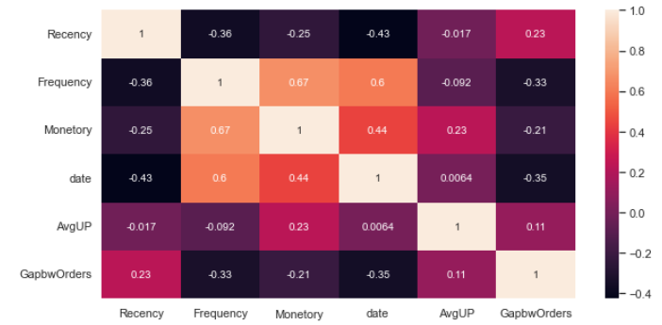
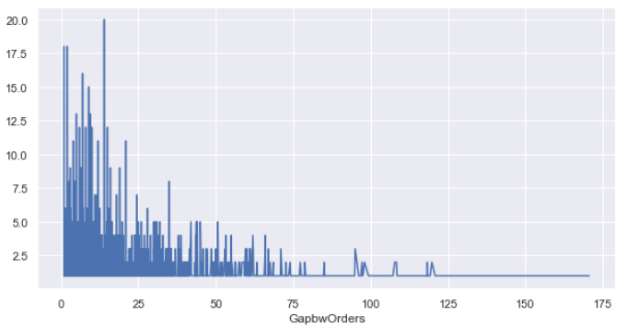
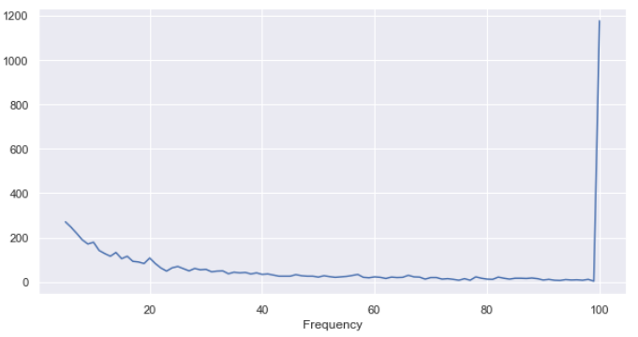
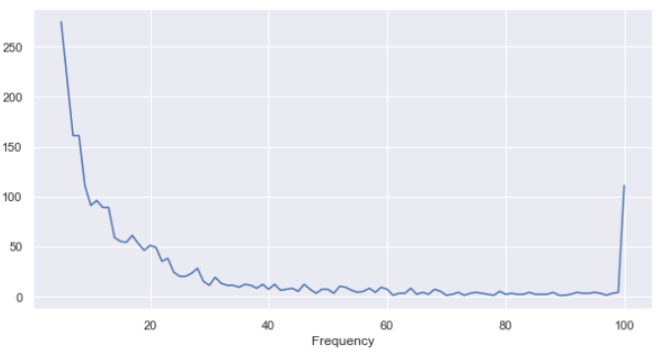
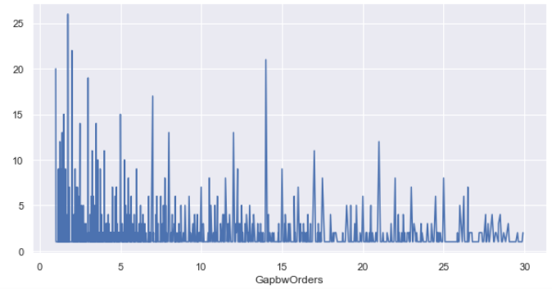
Exploratory data analysis
Frequency of transactions and Monetary value of transactions are highly correlated
Frequency of transactions and tenure period of merchant are highly correlated
Consecutive trnx gap trend for non churned merchant
Frequency trend for non churned merchant
Frequency trend for churned merchant
Consecutive trnx gap trend for churned merchant
Insight: Most of the churned merchants did make the 1-20 transactions in 2 years
Insight: Most of the churned merchants are uniformly distributed across 0 to 14 consecutive transaction gap while non churned merchants are left skewed from 0 to 25 gap days

Slide 9
Future scope
Time series forecasting
Since, we have time series data we can forecast the transactions with the help of past time series data
Proactively can manage resources and revenue. And can design the marketing strategies
Cohort analysis
Cohort analysis can be performed to get better insight into merchant engagement and retention
If there are any changes in Product offerings during this time period, its impact can be clearly quantified using Cohort Analysis
Recommendation system
We can design personalized recommendations for every merchant based on their product purchase history and use that for personalized targeting
We can design personalized recommendations for every merchant based on their product purchase history and use that for personalized targeting

